Slide 1
Bureaucracy
Yung-Yu Tsai

Slide 2
Outline
What is bureaucracy, and why is it important?
Who are bureaucrats, and how are they selected?
How can we improve the performance of our bureaucracy?

Slide 3
Outline
What is bureaucracy, and why is it important?
Who are bureaucrats, and how are they selected?
How can we improve the performance of our bureaucracy?

Slide 4
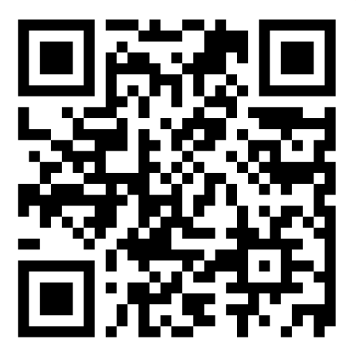
Who in the Government is the Most Influential?
Rank the influence of the following individuals on our country, from most influential (1) to least influential (5)
The President / Vice President
Members of Congress (House Representatives / Senators)
Supreme Court Justices
Heads of Federal Agencies (e.g., Secretary of Health and Human Services, Secretary of Transportation)
Front-line Federal Employees (e.g., clerks at USPS, workers at SSA, officers at TSA)
Login at slido.com
#CSU
Notes:
TSA = Transportation Security Administration

Slide 5
Who in the Government Do You Interact with the Most?
Rank the following individuals based on how frequently you interact with them, from most frequent (1) to least frequent (5)
The President / Vice President
Members of Congress (House Representatives / Senators)
Supreme Court Justices
Heads of Federal Agencies (e.g., Secretary of Health and Human Services, Secretary of Transportation)
Front-line Federal Employees (e.g., clerks at USPS, workers at SSA, officers at TSA)
Login at slido.com
#CSU
Notes:
TSA = Transportation Security Officers

Slide 6
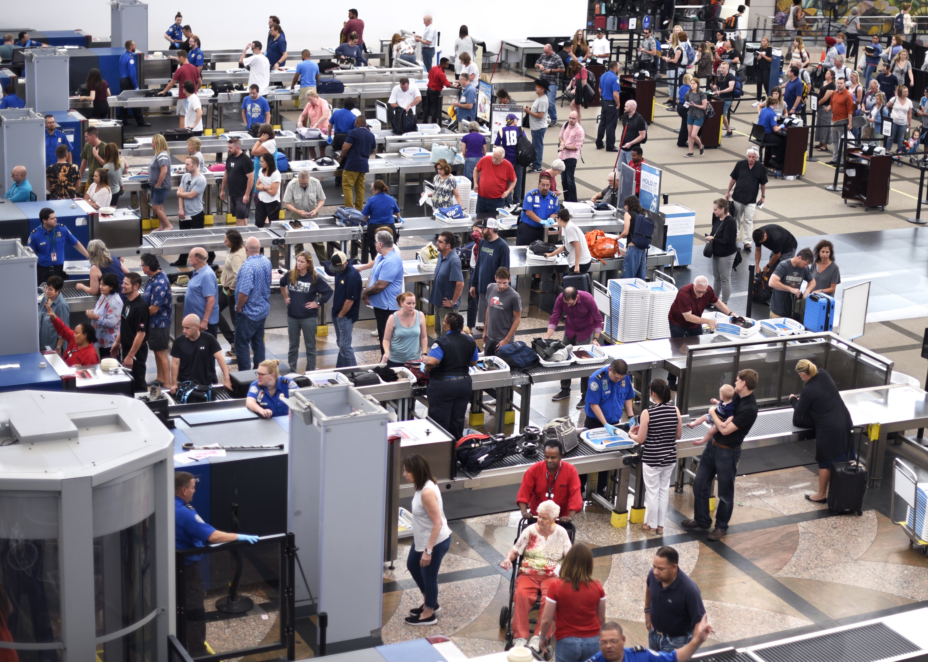
Why Are Bureaucrats Influential?
They implement policies set by the President and Congress
They interpret laws and determine how to apply them
They handle specific cases
They are the government officials that citizens most frequently encounter

Slide 7

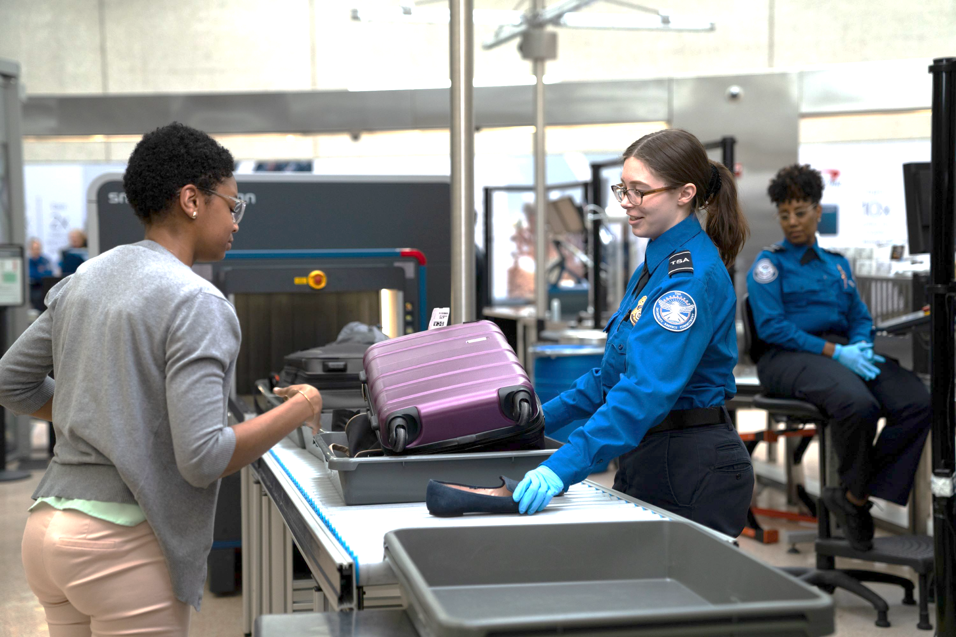
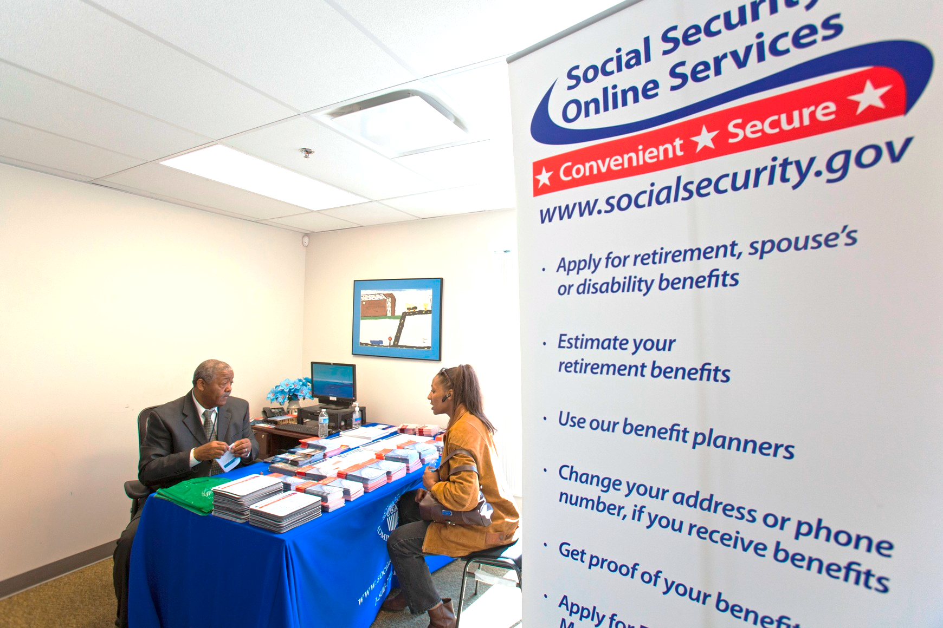
Government Officials You Interact with Most in Daily Life
Internal Revenue Service (IRS) Agents
Veterans Affairs (VA) Staff
Medicare and Medicaid Caseworkers
National Park Service (NPS) Rangers
Federal Student Aid (FSA) Office Employees
Department of Education Loan Servicers
Environmental Protection Agency (EPA) Inspectors
Customs and Border Protection (CBP) Officers

Slide 8
Different People in The Government
Political Appointees
Career Civil Servants
Elected Officials
Executive
Legislative
Judicial
e.g., President
e.g., Secretary of
Transportation
e.g., TSA Officers

Slide 9
Why do We Need Career Civil Servants?
Political Appointees
Career Civil Servants
Elected Officials
Why can’t we rely only on elected officials and political appointees?
We need professionals to handle routine government operations and maintain day-to-day services
Civil servants won’t leave due to election
Elected officials represent public opinion, but we also need decision-makers who apply laws and regulations impartially
Bureaucracy

Slide 10
Bureaucracy
Bureaucracy reflects a rationally organized hierarchical structure and administrative process composed of professional individuals working in and communicating from well-defined positions placed within a coordinated formal structure intentionally designed to achieve complex goals with maximum effectiveness and efficiency. (Simon et al. [2018] pp.377)
There are formal structures and processes to follow → red tape
They are professional and have designed goals to achieve
Their primary goals are effectiveness and efficiency

Slide 11
Outline
What is bureaucracy, and why is it important?
Who are bureaucrats, and how are they selected?
How can we improve the performance of our bureaucracy?

Slide 12
What Are the Traits You Find to be Typical for Bureaucrats / Civil Servants?
Arrogant | Difficult | Helpful | Responsible
Authoritative | Educated | Inflexible | Serving
Caring | Friendly | Job security | Stable
Conservative | Go home on time | Knowledgeable | Trustworthy
Corrupt | Hardworking | Lazy | Well paid
Login at slido.com
#CSU

Slide 13
A Study of Cross-national Analysis
of Public Employees Stereotype
Neo, S. et al. (2023). Working 9 to 5? A cross-national analysis of public sector worker stereotypes. Public Management Review, 1-30.
A total of 4,588 participants from the U.S., Canada, Netherlands, and South Korea
The study asks respondents to rate the top 5 traits they find to be typical for public sector workers
The results stand for people’s stereotypes

Slide 14
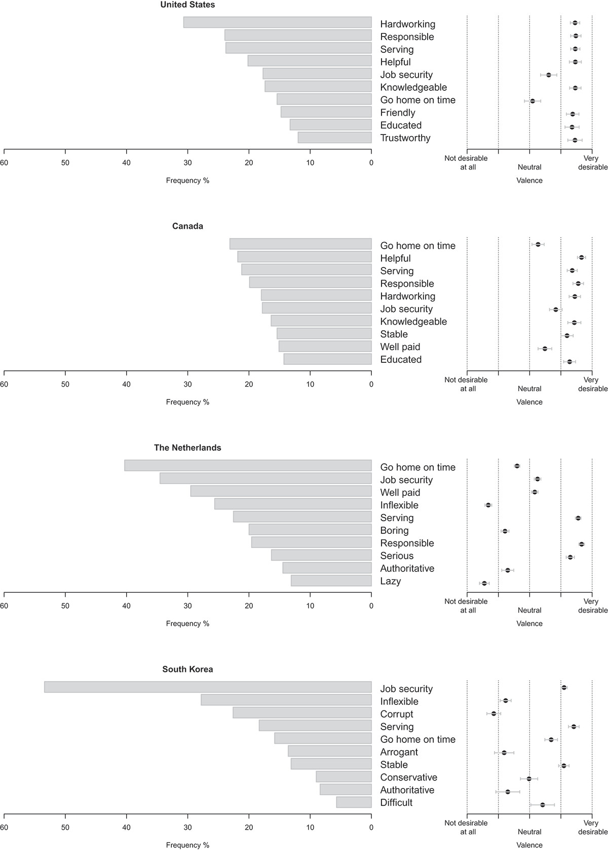
Comparison Across Countries
United States
Canada

Slide 15
Comparison Across Countries
Netherlands
South Korea

Slide 16
Key Takeaways
Observations
There are some positive perceptions (serving, knowledgeable, responsible)
Some neutral perceptions (job security, stability)
But, also some negative perceptions (inflexible, conservative, corrupt)
The perception varies across countries (different civil service systems)
Inspired Questions
What system characteristics lead to these traits? Why?
How could we make our civil service system have more positive traits and prevent the negative ones?

Slide 17
Key Elements of the Civil Service System
Hiring
Salary & Compensation
Separation (Firing)

Slide 18
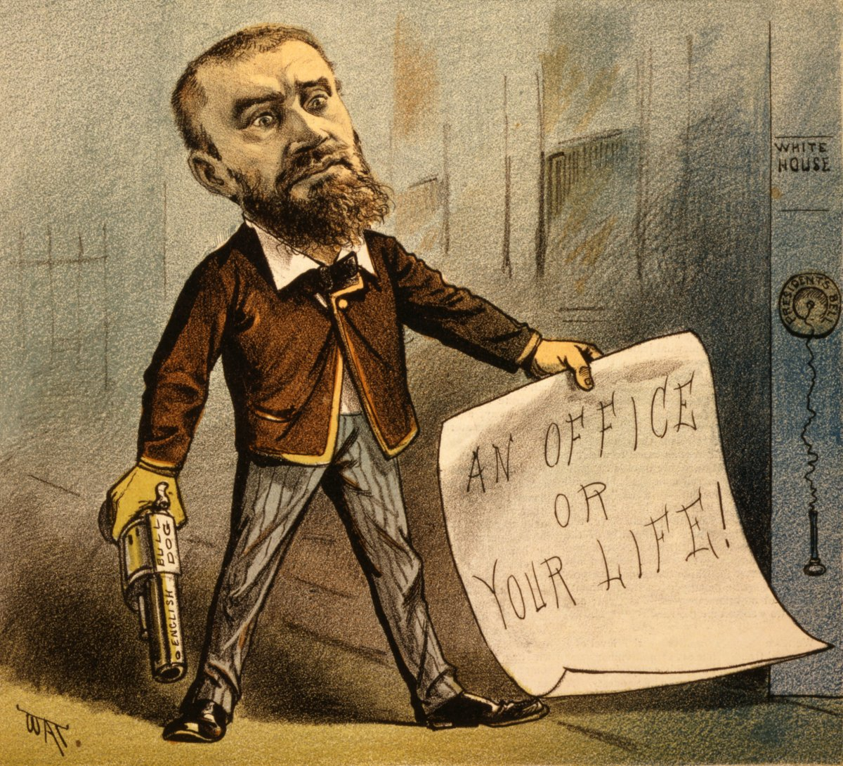
Spoils System
Give government jobs to supporters, friends, and family as a reward
Prevail in 1800s
In 1881, President James A. Garfield was assassinated by a rejected office-seeker
Push the Pendleton Civil Service Reform Act of 1883
Notes:
Figure source: https://origins.osu.edu/milestones/july-2016-assassination-president-garfield-135-years-ago?language_content_entity=en

Slide 19

Pendleton Civil Service Reform Act of 1883
Created the merit system
Promote and hire government employees based on their ability to perform a job rather than on their political connection
Created open, competitive examinations for testing the fitness of applicants for the public service
Ban spoil system: Senators and House Representatives can not make personnel recommendation
Ban promote, degrade, fire, change compensation for political reasons
Notes:
The Act: https://www.archives.gov/milestone-documents/pendleton-act

Slide 20
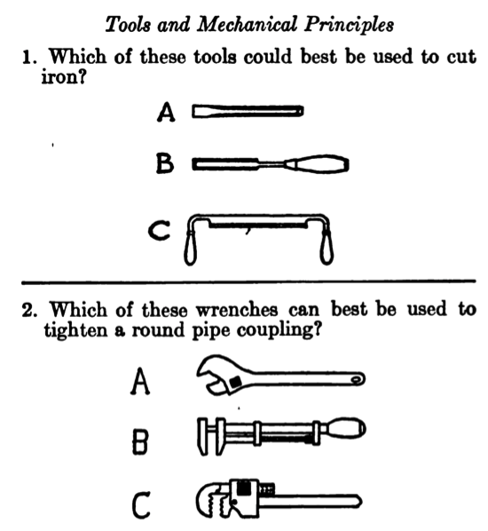
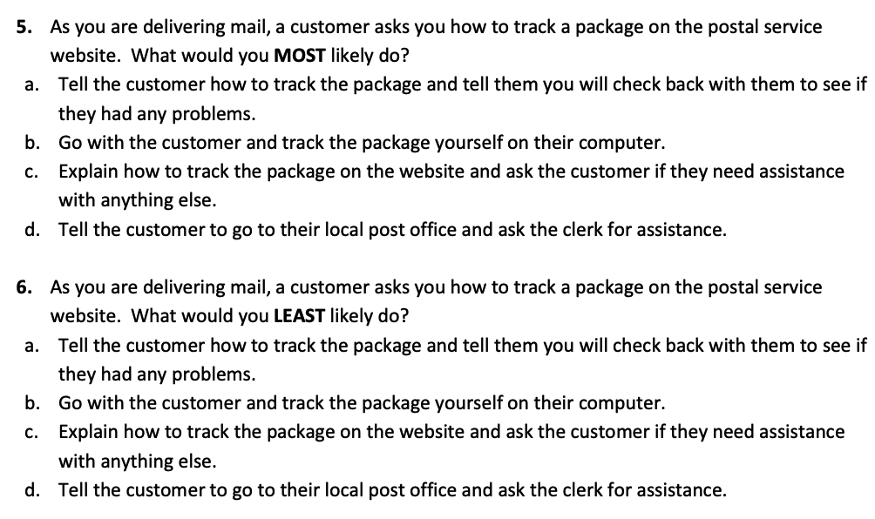
Questions for Mechanician
at National Park Service
Questions for the USPS Exam

Slide 21
States Adoption of Civil Service System
Federal Government Adopted Civil Setvice System
1943 Georgia Adopted
1989 West Virginia Adopted
Source: Ting, M. M., Snyder Jr, J. M., Hirano, S., & Folke, O. (2013). Elections and reform: The adoption of civil service systems in the US states. Journal of Theoretical Politics, 25(3), 363-387.
Notes:
Data source: Elections and reform: The adoption of civil service systems in the U.S. states

Slide 22
Separation in Civil Service
Career service protection
Removal (i.e., fire)
Serious matter: Misconduct, criminal or dishonest conduct, alcohol or drug abuse, engagement in overthrowing the Government
Unacceptable performance: the agency must provide employees the opportunity to demonstrate acceptable performance and assist the employee in improving performance
Employees have the right to appeal, a process that can take up to two years

Slide 23
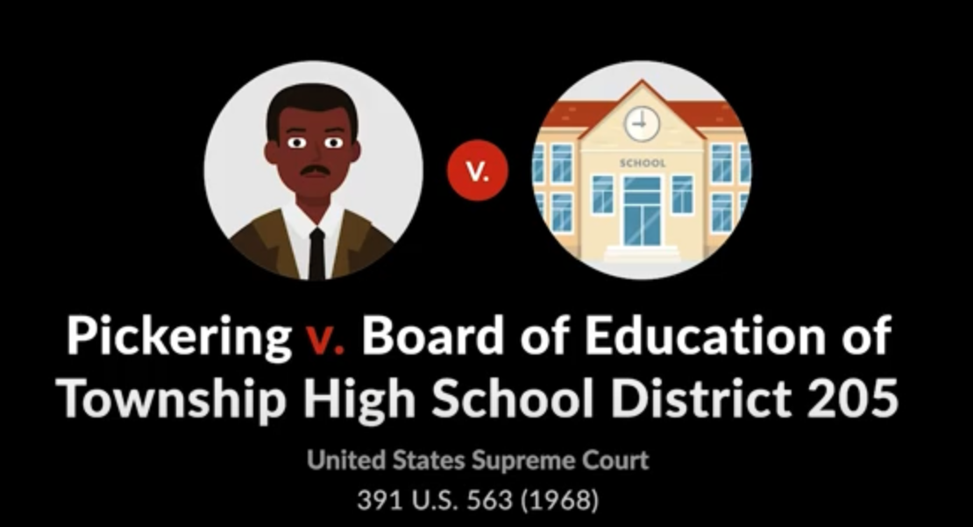
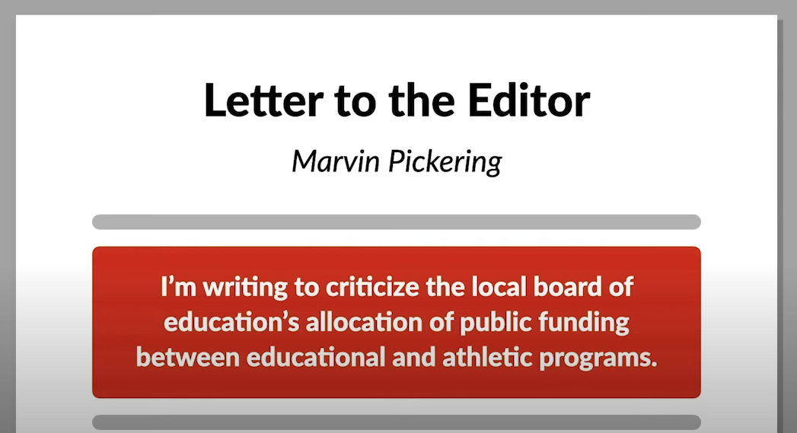

Slide 24
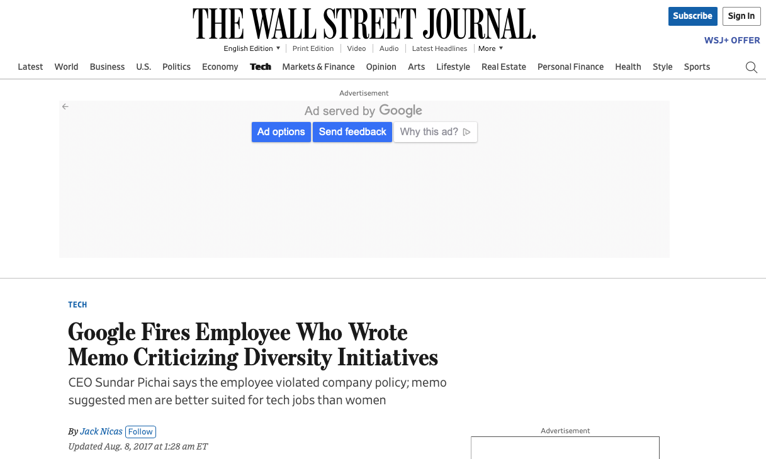
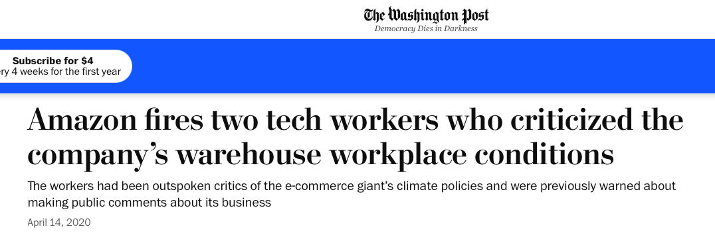

Slide 25
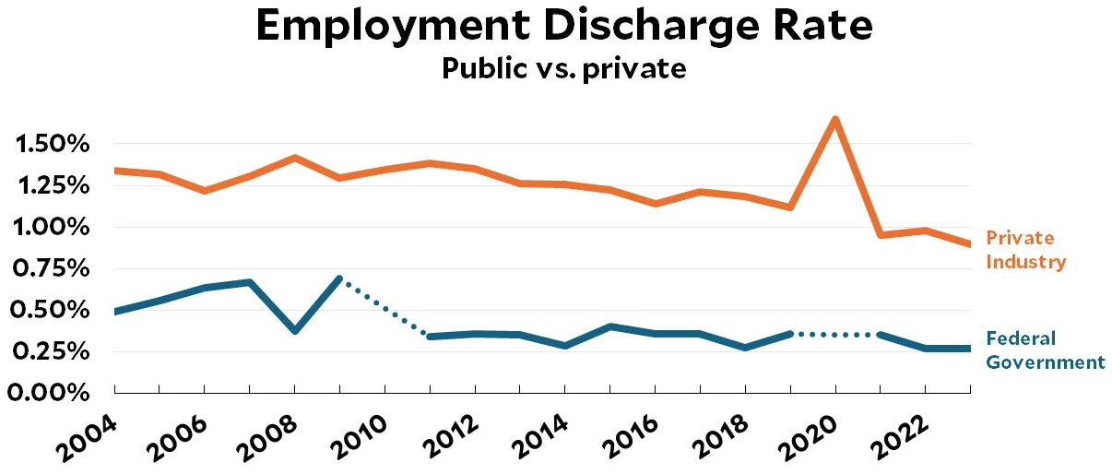
Notes:
https://jabberwocking.com/raw-data-the-number-of-people-fired-each-year/

Slide 26
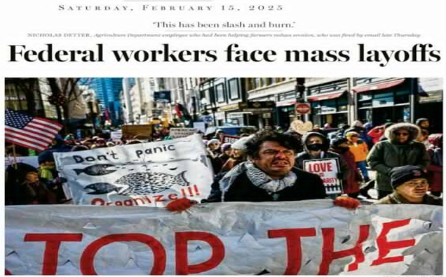
Reductions in Force (RIF)
RIF = Mass layoff in the federal government
Usually used when an agency faces a reorganization, a change in the agency’s workload, or a budget cut.
The focus of the RIF is on positions rather than individual employees.

Slide 27
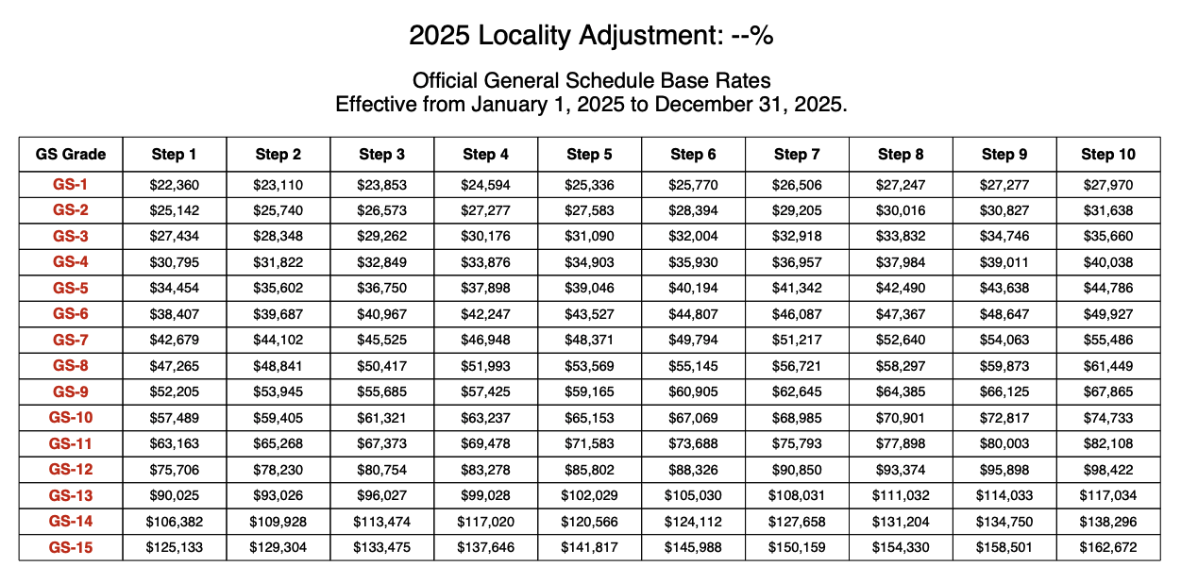
General entry-level
and professional →
Senior clerical and
entry-level professional
and administrative→
Senior clerical →
Full professional
or administrative→
Executive →

Slide 28
Examples of GS and Pay Scale at TSA
Transportation Security Officer
$43,876 - $56,282
Lead Transportation Security Officer
General Schedule (GS): 9
Supervisory Transportation Security Officer
General Schedule (GS):10-11
General Schedule (GS): 5-6
$61,111 - $79,443
$73,939 - $96,116
Assistant Federal Security Director
General Schedule (GS): 15
$165,626 - $204,331
Transportation Security Manager
General Schedule (GS):13
$105,383 - $137,000

Slide 29
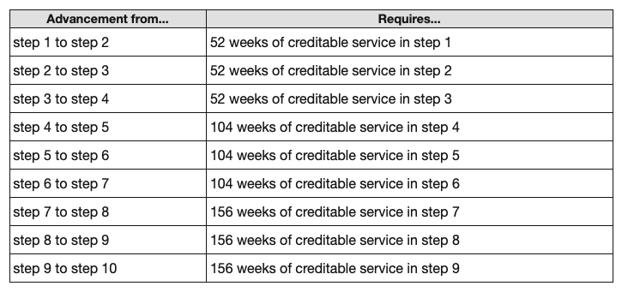
Within-Grade Increases in Salary
For employees with a scheduled tour of duty, the required waiting periods established by law for advancement to the next higher step are as follows:

Slide 30
Key Elements of the Civil Service System
Hiring
Salary & Compensation
Separation (Firing)
Based on merit (ability),
not political favoritism
Due process ensures protections
against arbitrary termination
Structured system based on
position and tenure

Slide 31
Think and Discuss
What civil service system characteristics bring us the positive traits that our bureaucrats have?
What civil service system characteristics bring us the negative traits that our bureaucrats have Or prevent them from having the positive ones?
Arrogant | Difficult | Helpful | Responsible
Authoritative | Educated | Inflexible | Serving
Caring | Friendly | Job security | Stable
Conservative | Go home on time | Knowledgeable | Trustworthy
Corrupt | Hardworking | Lazy | Well paid

Slide 32
Does Merit System Solve or Create Problems?
Merit System Elements | Advantages | Disadvantages
Selection of civic servants is based on open and competetive examanation | Prevents nepotism and political favoritism | Inflexibility in hiring and recruitment of good employees
Protect civil servants with career service system | Avoids political intervention and ensures administrative neutrality | Difficult to remove underperforming employees
Setting up rules on promotion and compensation | Avoids political intervention and ensures administrative neutrality | Limited tools to reward high-performing employees

Slide 33
Outline
What is bureaucracy, and why is it important?
Who are bureaucrats, and how are they selected?
How can we improve the performance of our bureaucracy?

Slide 34
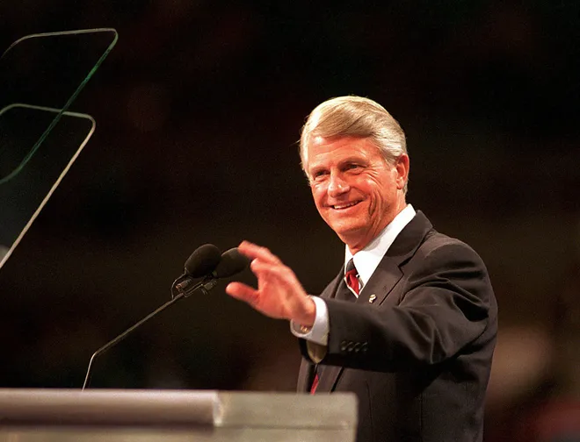
Does Merit System Solve or Create Problems?
“The truth of the matter is that a solution in 1943 (when the system was established) is a problem in 1996. …because, despite its name, our present merit system is not about merit. It offers no reward to good workers. It only provides cover for bad workers.”
Zell Miller
Governor of Georgia (1991–1999)

Slide 35
GeorgiaGain Reform
Georgia governor Zell Miller, in 1996, abolished the state’s merit system and had new employees serve at will
At-will employment: Public employees have no civil service protection and could be fired without the benefit of standard civil service procedures
Pay for performance: Replaced annual pay increases with a performance pay system

Slide 36
Other States’ Reforms
Several states followed Georgia and adopted some reforms to shift away from the merit system
South Carolina, 1997; Pennsylvania,1998; Vermont, 1999; Iowa, 1999; Oklahoma, 1999; Arkansas, 2001; North Dakota, 2001; Florida, 2001; Washington, 2002; Virginia, 2002; Kansas, 2003; Colorado, 2003; North Carolina, 2005; Arizona, 2012; Missouri, 2018…. And more…

Slide 37
Federal Civil Service Reform Act of 1978
Created Office of Personnel Management to replace the Civil Service Commission
Created pay-for-performance system (merit pay)
Created the Senior Executive Service (SES) level
Performance-based pay system
Performance awards (bonuses)
Created processes to remove underperforming employees (still hard)
Political Appointee
Senior Executive Service (SES)
Career Civil Servants
Elected Officials
Notes:
The Act: https://www.archives.gov/milestone-documents/pendleton-act

Slide 38
Do These Reforms Work?
Would you be more motivated to work at:
A workplace with “career protection,” where your job is secure, and salary increases are based primarily on years of service.
OR
A workplace with performance-based pay, where you can earn financial rewards for good performance but risk being fired for poor performance?

Slide 39
Do These Reforms Work?
Effects of GeorgiaGain Reform
Employees with better performance got more increase in salary
Employees with poor performance are more likely to get fired
Employees became less satisfied with their job
They think the performance evaluation is unfair and not effective
They are more likely to quit (even the good performance workers)
Evidence of other “pay-for-performance” systems in the government
Mixed evidence and a weak effect on performance
Source: Sanders, R. M. (2004). GeorgiaGain or GeorgiaLoss? The great experiment in state civil service reform. Public Personnel Management, 33(2), 151-164.
George, B., & van der Wal, Z. (2023). Does Performance-Related-Pay work? Recommendations for practice based on a meta-analysis. Policy Design and Practice, 1-14.

Slide 40
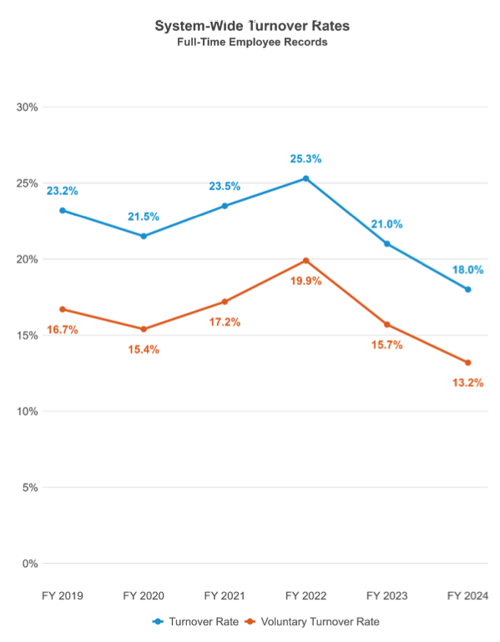
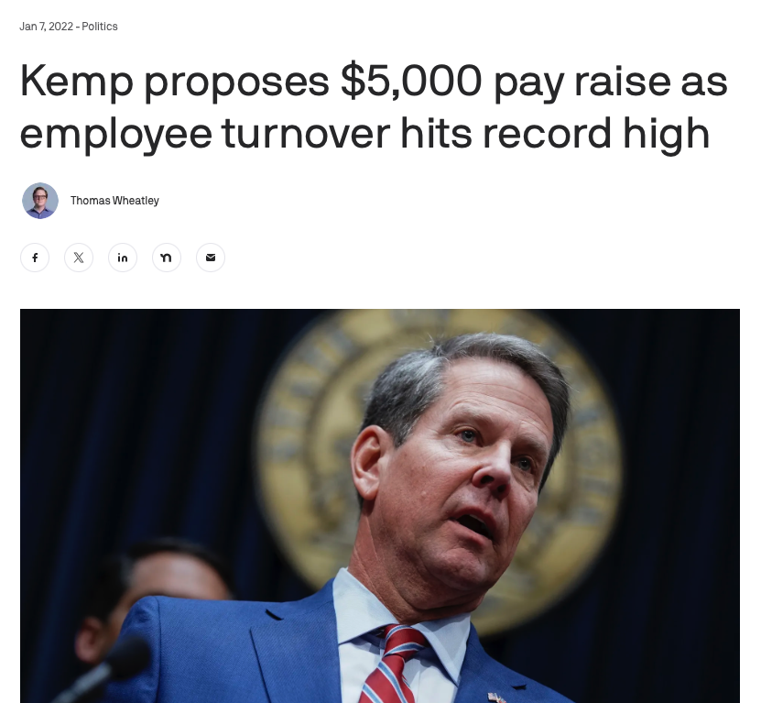

Slide 41

Why Is It So Hard to Measure Performance?
How do we measure performance in the private sector?
Outputs
Sales (values created for the company)
Customer satisfaction
How do we measure performance in the public sector?
Number of crimes arrested?
Amount of traffic tickets fines received?
Citizen satisfaction?

Slide 42
Key Takeaways from Today’s Class
Bureaucracy and bureaucrats play a crucial role in implementing policies, interpreting laws, and making decisions that affect daily life.
The civil service system ensures merit-based hiring, job protection, and standardized pay to promote stability and integrity
Creates inflexibility
Some modern reforms aim to fix the problems, but challenges remain
At-will employment
Pay-for-performance system
Question: What else could we do to improve our bureaucracy?

